Slide 1
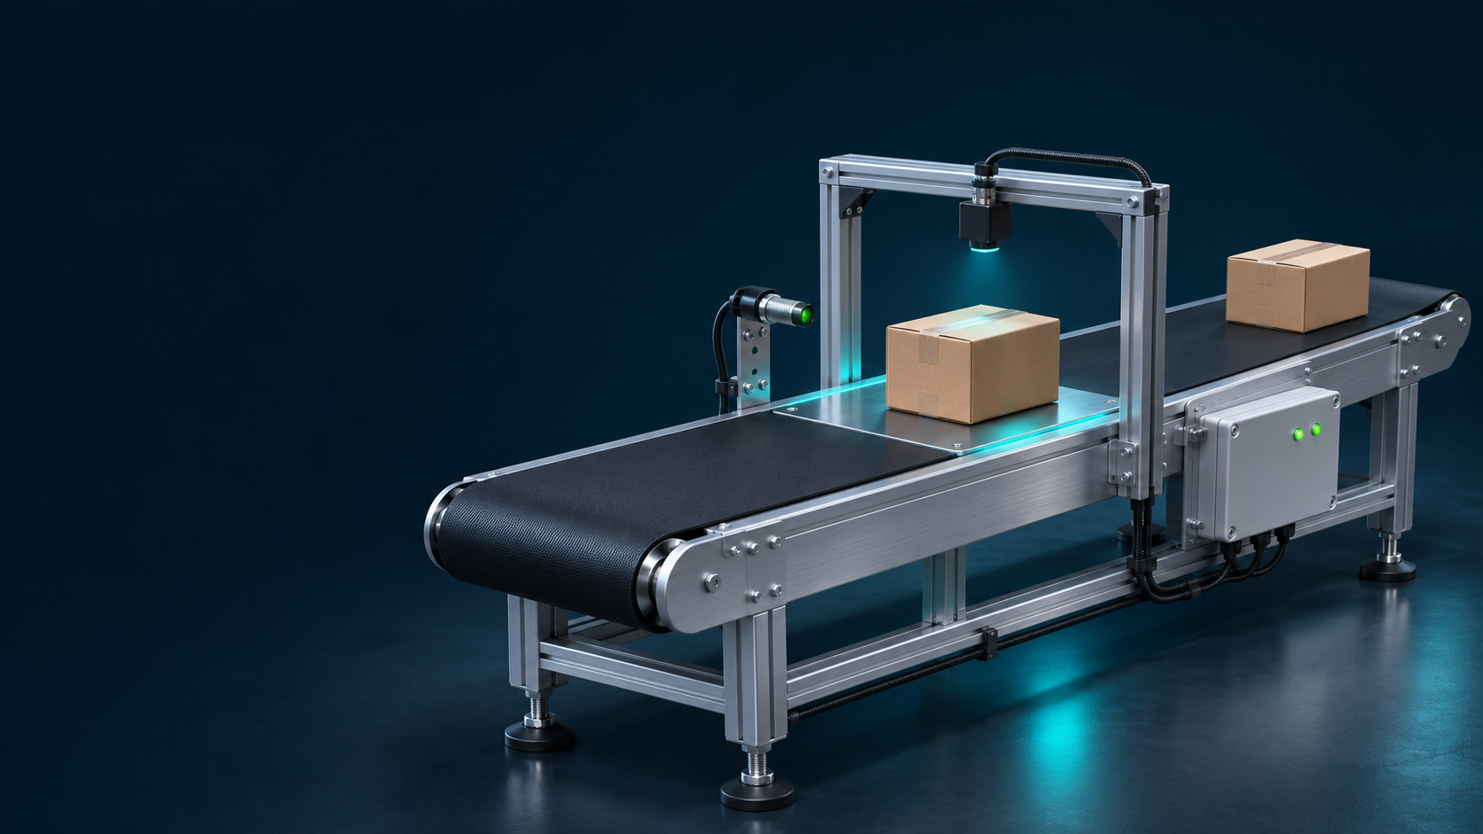
DESIGN SPECIFICATION
Smart Conveyor Weight Monitoring
and Overload Detection System
Wawasan Open University · TMS202/04 · Assignment 2, Question 2
PLC-based overload interlock with MQTT monitoring and C# Blazor Server dashboard
Team Member:
LAI JIUNN WEI
LIM JEROME
LIM ZHAO XIAN
LOGICAL CONVEYOR STATE
WOU | TMS202/04 | Assignment 2, Question 2
01
Notes:
Source boundary: project addresses, formulas and MQTT topics were supplied by the student in this conversation. They were not verified against source code, live equipment or captures. Figures are original editable reconstructions. No physical motor operation or measured load-cell accuracy is claimed.
Wawasan Open University. (2026). TMS202/04 IoT sensing devices and interfaces: Assignment 2 [Unpublished assignment brief].
Cover conveyor is a conceptual illustration. Student name and ID remain placeholders.

Slide 2
01 · TABLE OF CONTENTS
Specification structure
The eight required sections are retained in the order specified by Question 2.
01
Table of contents
02
05
Logic flow chart
07
02
Introduction
03
06
Network architecture diagram
08
03
System design
04
07
Schematic / wiring diagram
09
04
Component list and specifications
05
08
Implementation
10–12
Additional material: PLC mapping and scaling — 06 | Conclusion — 13 | References — 14
WOU | TMS202/04 | Assignment 2, Question 2
02
Notes:
Source boundary: project addresses, formulas and MQTT topics were supplied by the student in this conversation. They were not verified against source code, live equipment or captures. Figures are original editable reconstructions. No physical motor operation or measured load-cell accuracy is claimed.
Wawasan Open University. (2026). TMS202/04 IoT sensing devices and interfaces: Assignment 2 [Unpublished assignment brief].

Slide 3
02 · INTRODUCTION
Purpose, objectives and scope
A monitored conveyor scenario links product detection, weight conversion and a latched overload response.
Engineering objective
IIoT objective
Develop a PLC-based monitoring system that detects simulated product weights above 5.00 kg, automatically stops the simulated conveyor and permits controlled restarting after the abnormal condition is cleared.
Integrate WAGO CC100, Modbus RTU, Beaver IoT MQTT and C# Blazor to enable real-time monitoring, remote START/STOP commands and command acknowledgement.
Scope: PLC logic, mapped inputs, Modbus data, MQTT exchange and dashboard behaviour.
Boundary: no verified load cell, motor wiring, physical stopping distance or test results.
WOU | TMS202/04 | Assignment 2, Question 2
03
Notes:
Source boundary: project addresses, formulas and MQTT topics were supplied by the student in this conversation. They were not verified against source code, live equipment or captures. Figures are original editable reconstructions. No physical motor operation or measured load-cell accuracy is claimed.
The supplied description defines intended system behaviour. Implementation and hardware evidence are still needed.

Slide 4
03 · SYSTEM DESIGN
Local interlock, networked monitoring
The PLC owns the overload decision; the dashboard presents state and sends requests.
Sensor Inputs
PNP Production Detection
Weight Input Signal
WAGO PLC
Weight Calculation
Overload Protection
MQTT + Blazor
Live Monitoring
Remote Start/Stop
Automatic overweight stop
Operator-controlled recovery
Weight > 5.00 kg sets the alarm latch and clears the logical run request. A later reduction in weight alone does not restart the system.
Remove the product, then press Start. Restart is accepted only after the overload condition has cleared; remote requests must not bypass the latch.
WOU | TMS202/04 | Assignment 2, Question 2
04
Notes:
Source boundary: project addresses, formulas and MQTT topics were supplied by the student in this conversation. They were not verified against source code, live equipment or captures. Figures are original editable reconstructions. No physical motor operation or measured load-cell accuracy is claimed.
Logical run request and alarm latch are descriptive state labels, not confirmed source-code symbol names. Restart inhibit while overload persists is the safe design interpretation, pending comparison with the actual ST program.

Slide 5
04 · COMPONENT LIST AND SPECIFICATIONS
Components and verification boundary
Controller capabilities: WAGO (n.d.). Project mappings and installed equipment are distinguished below.
Table 1. Principal hardware and software
Component | Verified / supplied specification | Project role / limitation
WAGO CC100 751-9301 | 8 DI, 4 DO, 2 AI, 2 AO; 1 RS485; 2 Ethernet | PLC at 192.168.101.190. No DO or motor mapping supplied.
NP9 push button | Digital input %IX0.0 (project-supplied mapping) | Local restart request. Contact arrangement to confirm.
PNP proximity sensor | Digital input %IX0.1 (model not supplied) | Product detection. Polarity and rating to confirm.
Modbus measurement path | PLC input word %IW5 (module model not supplied) | Raw value for conversion. Source and register map to confirm.
Beaver IoT + Blazor Server | Broker 192.168.101.59:1883; C# with MQTTnet | Messaging and dashboard. Installed versions to confirm.
Assignment-listed supply, terminals, converters, LEDs, display and temperature probe: installed use requires confirmation.
WOU | TMS202/04 | Assignment 2, Question 2
05
Notes:
Source boundary: project addresses, formulas and MQTT topics were supplied by the student in this conversation. They were not verified against source code, live equipment or captures. Figures are original editable reconstructions. No physical motor operation or measured load-cell accuracy is claimed.
WAGO. (n.d.). Compact Controller 100 (751-9301). https://www.wago.com/global/plcs-%E2%80%93-controllers/compact-controller-100/p/751-9301
MQTTnet contributors. (n.d.). MQTTnet [Computer software]. GitHub. https://github.com/dotnet/MQTTnet
Microsoft. (n.d.). ASP.NET Core Blazor hosting models. Microsoft Learn. https://learn.microsoft.com/en-us/aspnet/core/blazor/hosting-models
Wawasan Open University. (2026). TMS202/04 IoT sensing devices and interfaces: Assignment 2 [Unpublished assignment brief].

Slide 6

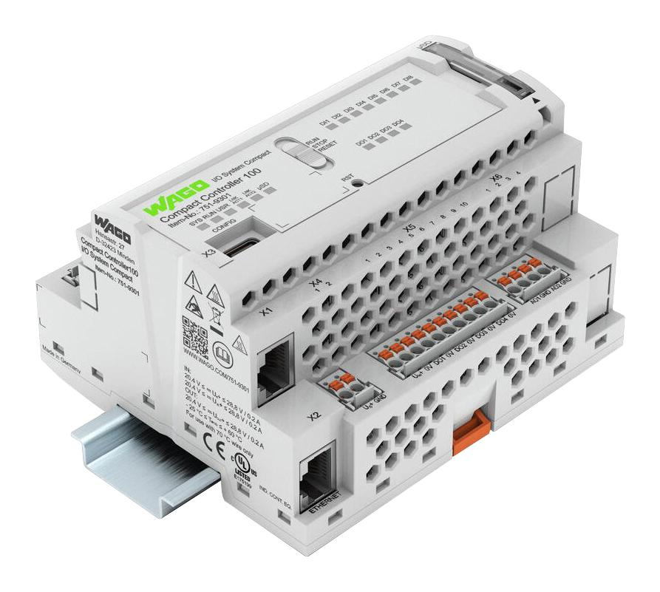
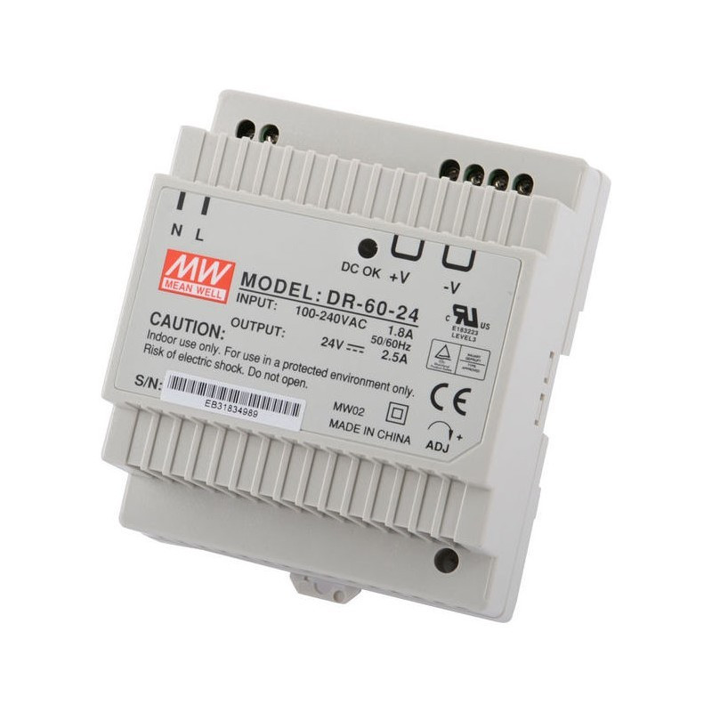
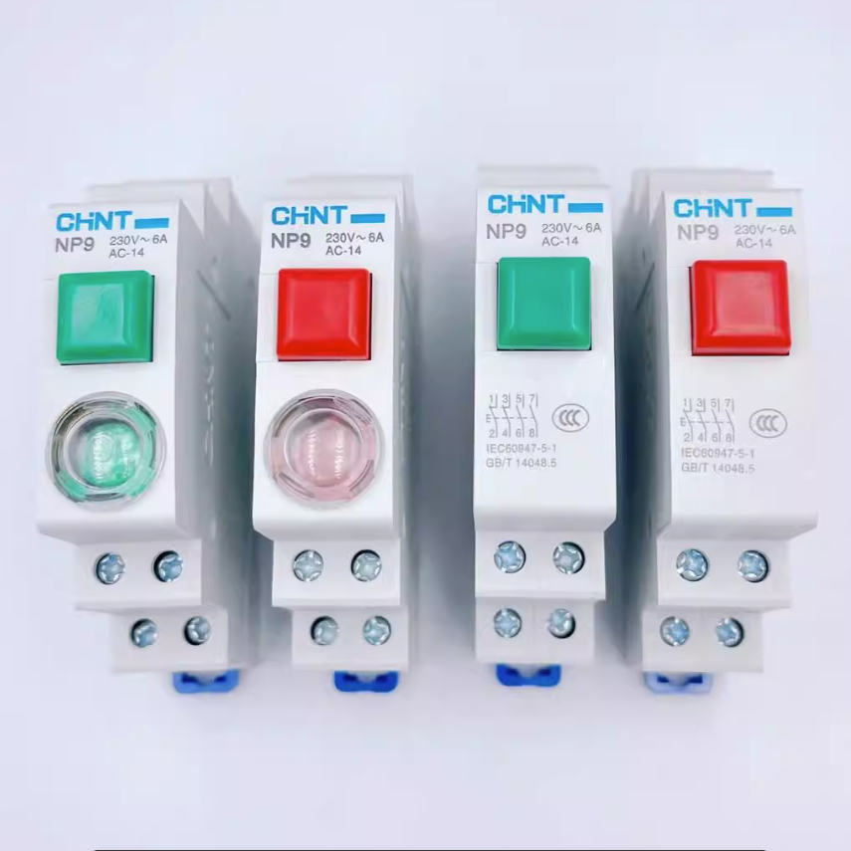
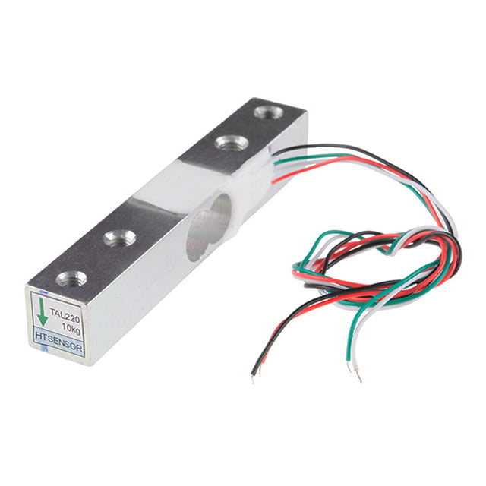
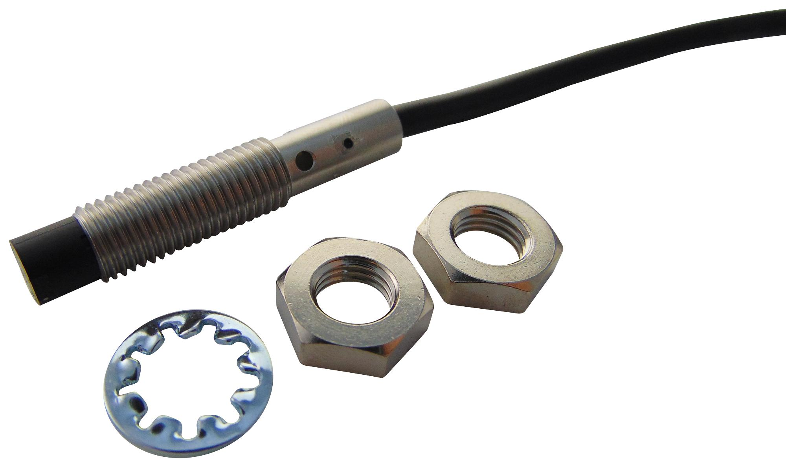
COMPONENTS
Main hardware components
Control, power, operator input and proposed sensing hardware
WAGO CC100
MEAN WELL
CHINT NP9
Proximity sensor
Load cell
751-9301
DR-60-24
Push-button series
PNP inductive example
TAL220 example
PLC control and overload logic
Ethernet / MQTT link
24 V DC power supply
Rated output: 2.5 A / 60 W
Local start / restart request
Contact type to confirm
Detects metal targets
Exact model to confirm
Proposed weight input
Requires weighing interface
WOU | TMS202/04 | Assignment 2, Question 2
06
Notes:
Web product reference images, not photographs of the installed project hardware.
WAGO 751-9301: https://mexico.newark.com/wago/751-9301/plc-processor-led-2-analog-i-o/dp/26AK5511
MEAN WELL DR-60-24: https://www.domadoo.fr/fr/peripheriques/3291-gce-electronics-alimentation-24v-rail-din-60w.html
CHINT NP9 series: https://www.ebay.ca/itm/266419108363
NP9 photograph shows multiple contact/indicator variants. Exact installed configuration remains to be confirmed.
RS485 module and display are omitted because their exact models are not confirmed.
Proximity reference: Omron E2B-S08KN04-WP-B1 PNP inductive sensor. Detects metallic targets, not cardboard directly. https://www.ia.omron.com/products/family/3203/specification.html
Sensor image: https://uk.farnell.com/omron-industrial-automation/e2b-s08kn04-wp-b1-2m-oms/inductive-proximity-sensor-4mm/dp/2667261
Load cell reference: TAL220 10 kg, proposed example only. Capacity and installed model are unconfirmed. A compatible signal-conditioning/weighing transmitter or ADC interface is required before PLC integration. https://www.sparkfun.com/load-cell-10kg-straight-bar-tal220.html
Load cell image: https://www.digikey.ph/en/products/detail/sparkfun-electronics/13329/7393715

Slide 7
03 · SYSTEM DESIGN / DATA MAPPING
PLC inputs and weight conversion
Addresses are supplied project mappings; source-code variable names were not supplied.
Table 2. PLC process-image mapping
Specified conversion
Address | Signal | Use
%IX0.0 | NP9 push button | Restart input
%IX0.1 | PNP proximity sensor | Product presence
%IW5 | Modbus measurement word | Raw input for scaling
Voltage = (Raw Input / 1000) × 100
Weight (kg) = Voltage / 10
Therefore: Weight (kg) = Raw / 100
Calculated example: Raw = 500 → Voltage = 50 → Weight = 5.00 kg.
Use REAL arithmetic to avoid truncation during integer division.
“Voltage” is the project’s scaling variable; its physical unit and calibration are unverified. This is not a 50 V terminal claim.
WOU | TMS202/04 | Assignment 2, Question 2
07
Notes:
Source boundary: project addresses, formulas and MQTT topics were supplied by the student in this conversation. They were not verified against source code, live equipment or captures. Figures are original editable reconstructions. No physical motor operation or measured load-cell accuracy is claimed.

Slide 8
05 · LOGIC FLOW CHART
Overweight latch and restart sequence
Figure 1. System Logic Flowchart — design interpretation of the supplied operating sequence.
Weight
> 5.00 kg?
No: remain stopped and latched.
Each PLC scan returns to input acquisition.
Read inputs
and calculate weight
Yes
Set alarm latch
Clear run request
No
Removed + clear?
New NP9 press?
Alarm
latched?
Maintain permitted
logical run state
No
Yes
Yes
Clear latch
Re-enable logical run
Initial startup state, sensor polarity and button edge/debounce must be checked in the actual program.
WOU | TMS202/04 | Assignment 2, Question 2
08
Notes:
Source boundary: project addresses, formulas and MQTT topics were supplied by the student in this conversation. They were not verified against source code, live equipment or captures. Figures are original editable reconstructions. No physical motor operation or measured load-cell accuracy is claimed.
Overweight comparison uses strictly greater than 5.00 kg for this specification. ProductRemoved is a conceptual condition; no unprovided PLC tag or sensor inversion is asserted. Loopbacks are described in the scan note to avoid crossing the flowchart.

Slide 9
06 · NETWORK ARCHITECTURE DIAGRAM
PLC–broker–dashboard communication
Figure 2. IIoT Network Architecture Diagram — IP addresses and topic roles from the project specification.
Telemetry / status →
← Command requests
WAGO CC100
192.168.101.190
CODESYS ST + MQTT client
Beaver IoT MQTT broker
192.168.101.59 : 1883
C# Blazor Server
MQTTnet client
PC IP: to confirm
Local Ethernet network / router
Subnet mask and gateway: to confirm
Arrows show application data roles; all MQTT clients communicate through the broker. Exact topics appear on slide 11.
WOU | TMS202/04 | Assignment 2, Question 2
9
Notes:
Source boundary: project addresses, formulas and MQTT topics were supplied by the student in this conversation. They were not verified against source code, live equipment or captures. Figures are original editable reconstructions. No physical motor operation or measured load-cell accuracy is claimed.
OASIS. (2014, October 29). MQTT version 3.1.1. https://docs.oasis-open.org/mqtt/mqtt/v3.1.1/os/mqtt-v3.1.1-os.html
Microsoft. (n.d.). ASP.NET Core Blazor hosting models. Microsoft Learn. https://learn.microsoft.com/en-us/aspnet/core/blazor/hosting-models
MQTTnet contributors. (n.d.). MQTTnet [Computer software]. GitHub. https://github.com/dotnet/MQTTnet
The Blazor browser UI connects to the server application; MQTTnet is server-side. The PC address is not assumed to equal the broker address. Dashed lines represent LAN connectivity, not additional MQTT routes. Authentication, TLS, QoS and retain configuration are unknown.

Slide 10
07 · SCHEMATIC / WIRING DIAGRAM
Functional wiring and PLC input mapping
Figure 3. Functional Schematic / Wiring Diagram — terminal numbers and motor wiring are intentionally unspecified.
24 V DC supply
Rating / model: confirm
24 V / 0 V functional supply
Measurement source /
Modbus converter
Model / transport: confirm
WAGO CC100
Digital signal
NP9 contact
Configuration: confirm
NP9 → %IX0.0
PNP signal
PNP sensor
Supply / 0 V / signal
PNP → %IX0.1
Confirm shared reference, sensor polarity,
Modbus transport and field wiring against
the actual hardware before energising.
Modbus → %IW5
Functional connections only: no load-cell circuit, motor driver, relay, DO address or physical stop response has been evidenced.
WOU | TMS202/04 | Assignment 2, Question 2
10
Notes:
Source boundary: project addresses, formulas and MQTT topics were supplied by the student in this conversation. They were not verified against source code, live equipment or captures. Figures are original editable reconstructions. No physical motor operation or measured load-cell accuracy is claimed.
The assignment lists a DIN-rail 24 V supply and RS485/Modbus converter. Their exact models and physical routes are not supplied. Supply to peripheral devices and all terminal designations must be confirmed from actual ratings and manuals. %IW5 is a PLC address, not a Modbus wire or terminal number.

Slide 11
08 · IMPLEMENTATION
PLC scan order and restart priority
CODESYS Structured Text implements conversion and state logic (CODESYS GmbH, n.d.).
01
Acquire and convert
Read %IW5 using real-number arithmetic. Apply the supplied conversion and compare derived weight with 5.00 kg.
02
Give overload priority
If overweight is true, set the alarm latch and clear the internal run request in the same control cycle.
03
Retain the stopped state
Do not clear the latch merely because weight falls. Keep the logical run request inhibited until recovery is authorised.
04
Accept local recovery
After product removal and overload clearance, a new NP9 press requests latch reset and logical restart.
Verify the startup state, latch persistence, NP9 edge detection, input polarity and remote-command precedence in the actual ST code.
WOU | TMS202/04 | Assignment 2, Question 2
11
Notes:
Source boundary: project addresses, formulas and MQTT topics were supplied by the student in this conversation. They were not verified against source code, live equipment or captures. Figures are original editable reconstructions. No physical motor operation or measured load-cell accuracy is claimed.
CODESYS GmbH. (n.d.). ST editor. https://content.helpme-codesys.com/en/CODESYS%20Development%20System/_cds_edt_st_editor.html

Slide 12
08 · IMPLEMENTATION
MQTT topic contract
Broker: 192.168.101.59:1883. Separate topics carry telemetry, commands and application status.
Telemetry
PLC / edge → broker → dashboard
beaver-iot/mqtt@default/mqtt-device/LAIJIUNNWEI_CA2
Command
Dashboard → broker → PLC / edge
ca2/conveyor/command
Acknowledgement / status
PLC / edge → broker → dashboard
ca2/conveyor/status
Payload fields, command strings, QoS, retain and credentials: confirm from the project. Application status is not MQTT PUBACK (OASIS, 2014).
WOU | TMS202/04 | Assignment 2, Question 2
12
Notes:
Source boundary: project addresses, formulas and MQTT topics were supplied by the student in this conversation. They were not verified against source code, live equipment or captures. Figures are original editable reconstructions. No physical motor operation or measured load-cell accuracy is claimed.
OASIS. (2014, October 29). MQTT version 3.1.1. https://docs.oasis-open.org/mqtt/mqtt/v3.1.1/os/mqtt-v3.1.1-os.html
MQTTnet contributors. (n.d.). MQTTnet [Computer software]. GitHub. https://github.com/dotnet/MQTTnet
Topic names are exact user-supplied strings. Direction is the functional contract implied by telemetry, command and acknowledgement roles. An application status message should report accepted/rejected command and resulting logical state; its actual payload is not supplied. MQTT PUBACK only acknowledges protocol delivery at QoS 1, not physical action.

Slide 13
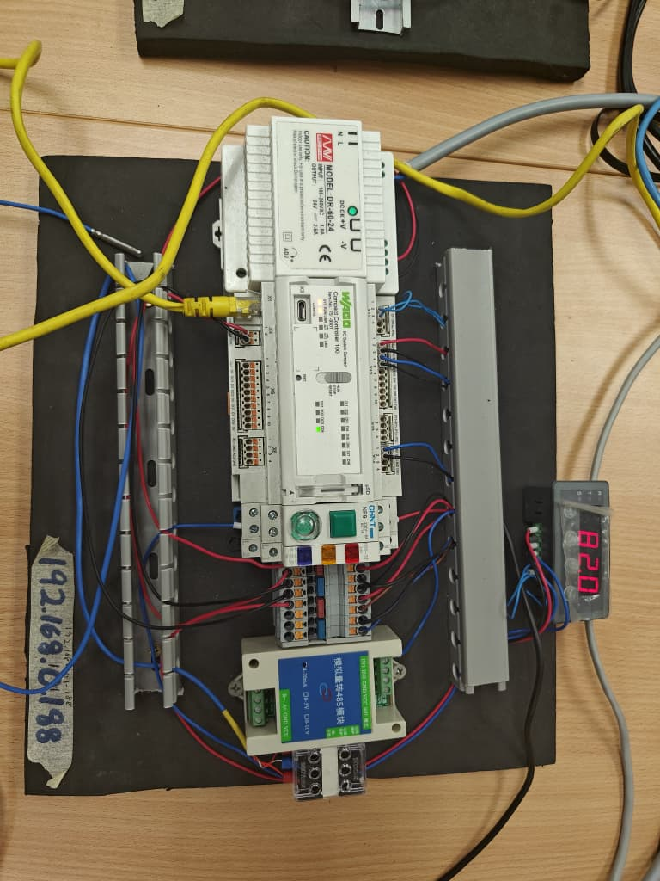
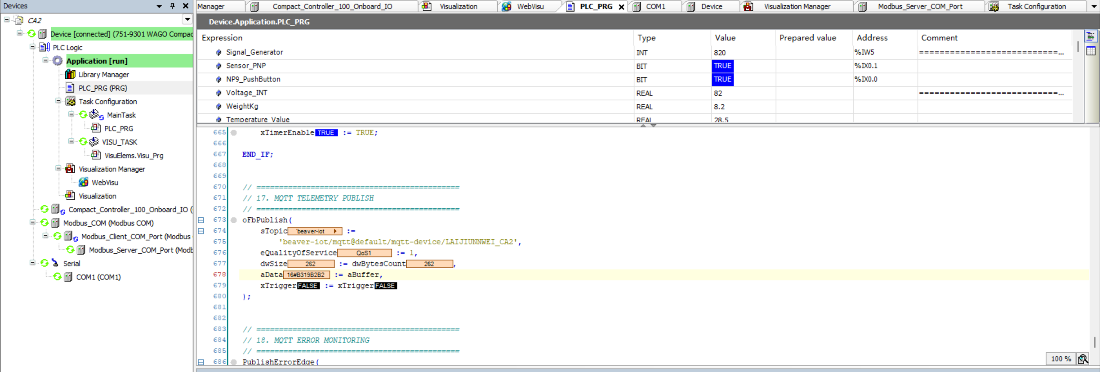
08 · IMPLEMENTATION
Dashboard, evidence and traceability
Blazor Server hosts the interface; MQTTnet handles messaging
Display derived weight, product presence, overload latch, logical run state and connection status.
Show command feedback separately from the requested action. Label simulated input values clearly.
E1 · Hardware photo
E2 · CODESYS
WOU | TMS202/04 | Assignment 2, Question 2
13
Notes:
Source boundary: project addresses, formulas and MQTT topics were supplied by the student in this conversation. They were not verified against source code, live equipment or captures. Figures are original editable reconstructions. No physical motor operation or measured load-cell accuracy is claimed.
Microsoft. (n.d.). ASP.NET Core Blazor hosting models. Microsoft Learn. https://learn.microsoft.com/en-us/aspnet/core/blazor/hosting-models
MQTTnet contributors. (n.d.). MQTTnet [Computer software]. GitHub. https://github.com/dotnet/MQTTnet
Evidence placeholders are intentionally empty. No dashboard mock-up is presented as a working application. Recommended UI distinction: waiting for data, fresh no-product reading, and stale/disconnected data are separate states. No timeout implementation is asserted.

Slide 14
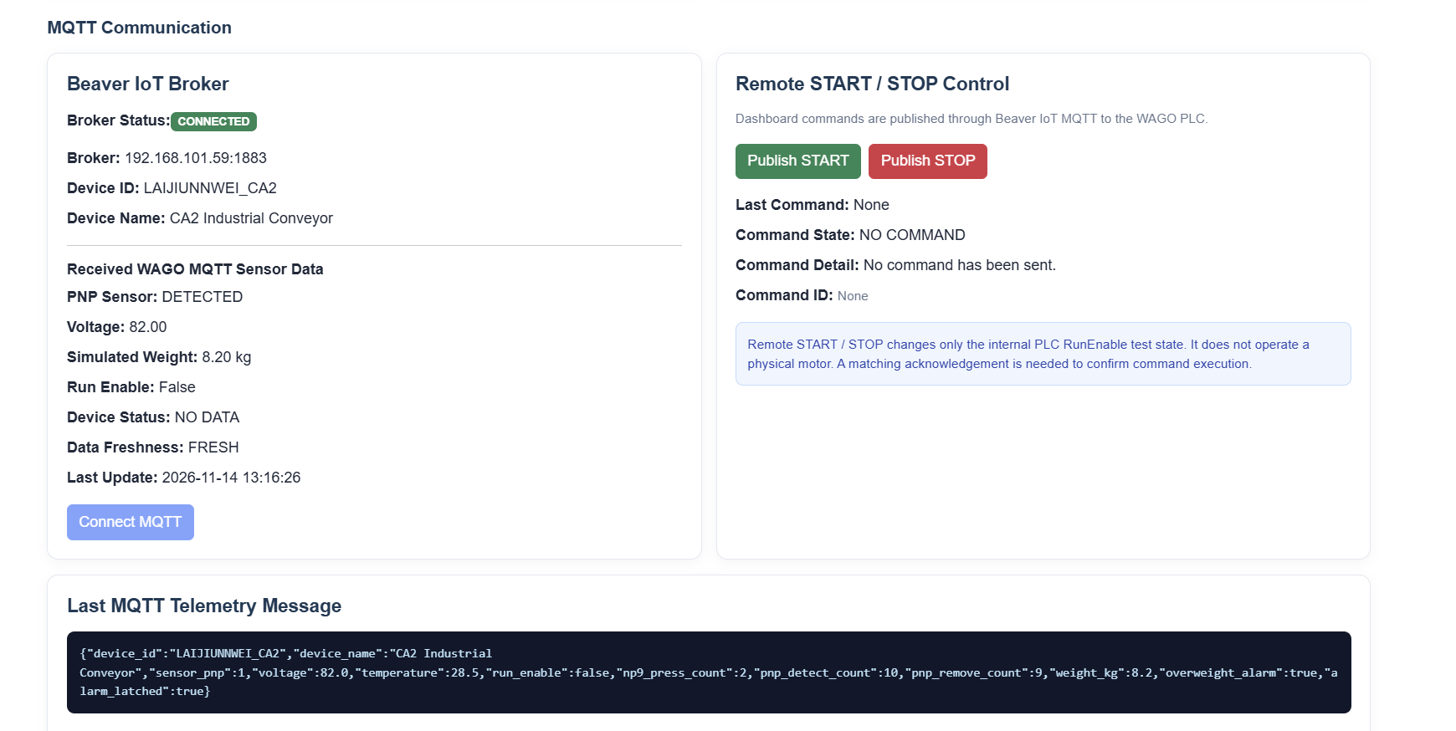
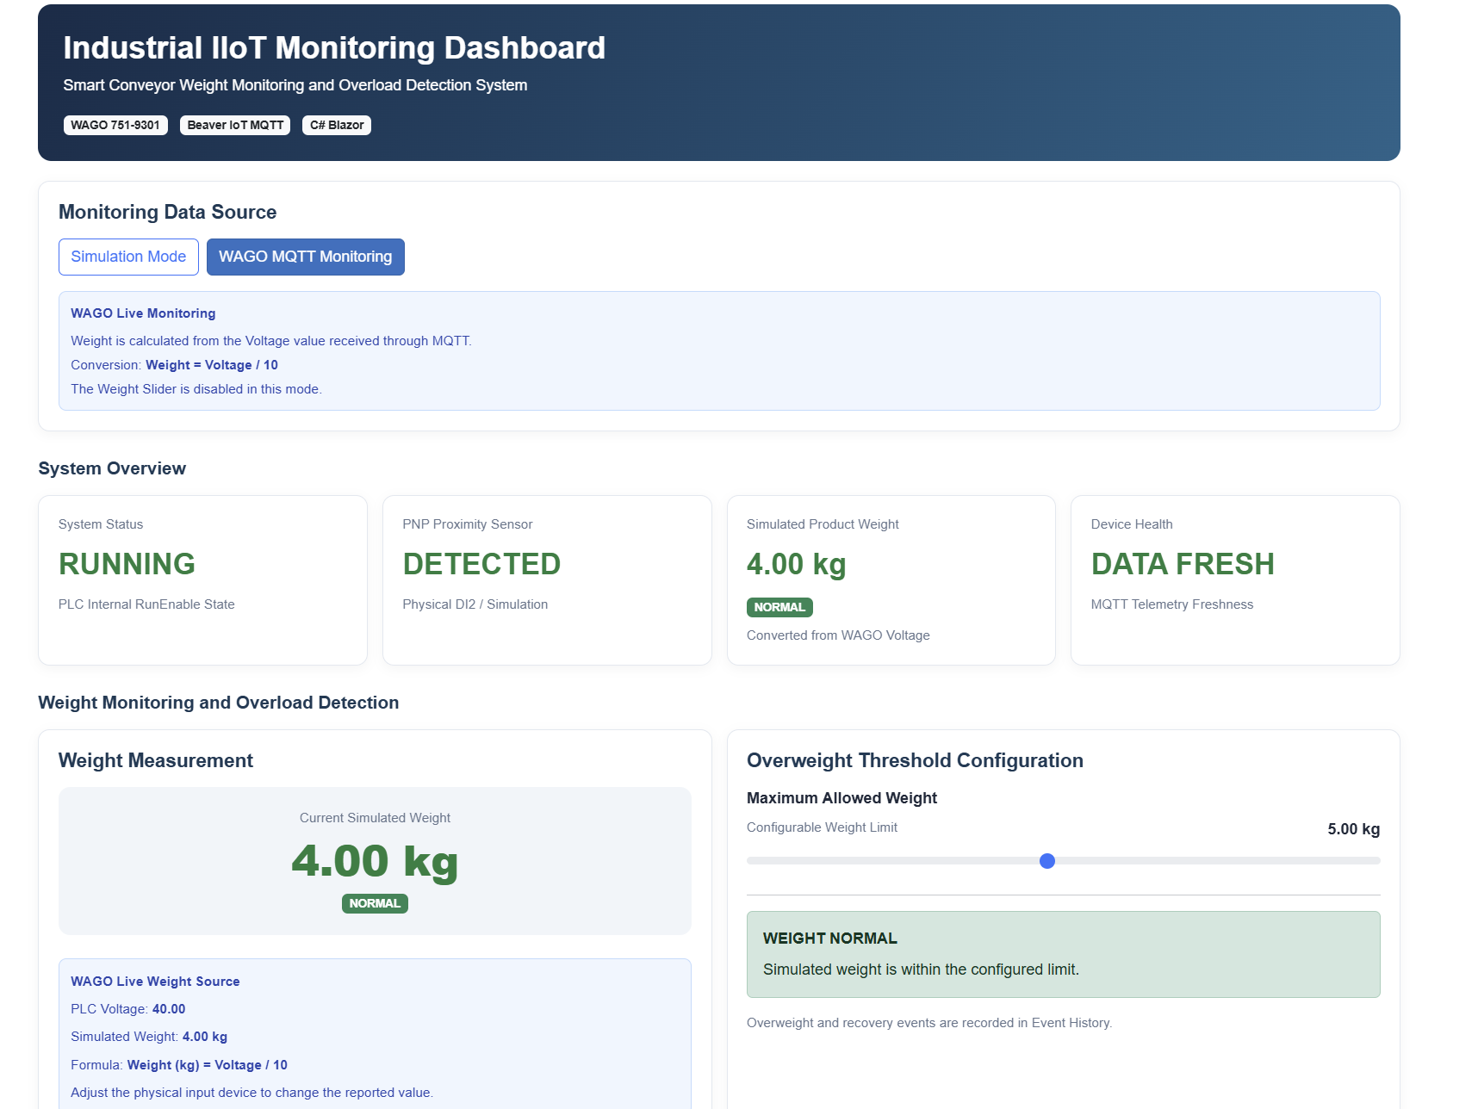
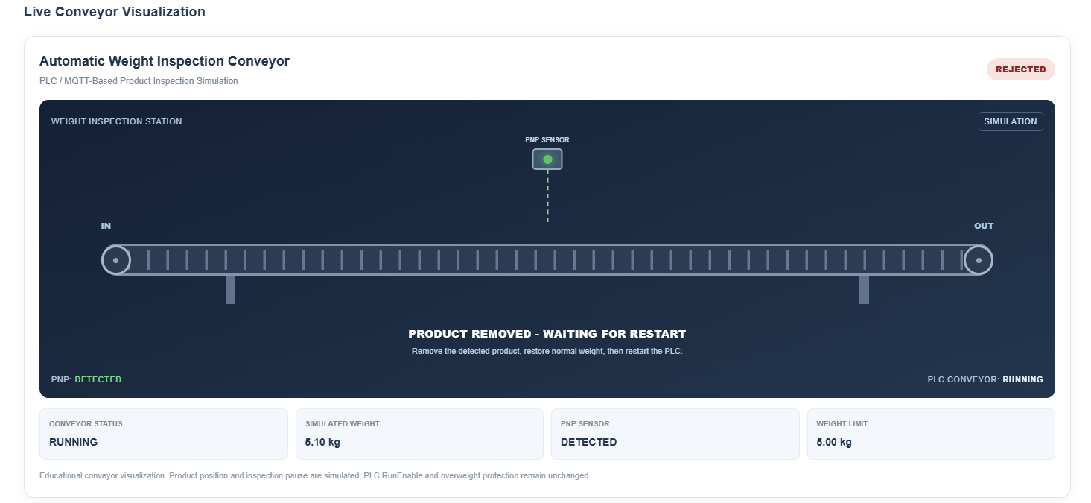
08 · IMPLEMENTATION
Dashboard, evidence and traceability
E3 · MQTT evidence
E4 · Dashboard
E3 · MQTT evidence
WOU | TMS202/04 | Assignment 2, Question 2
14
Notes:
Source boundary: project addresses, formulas and MQTT topics were supplied by the student in this conversation. They were not verified against source code, live equipment or captures. Figures are original editable reconstructions. No physical motor operation or measured load-cell accuracy is claimed.
Microsoft. (n.d.). ASP.NET Core Blazor hosting models. Microsoft Learn. https://learn.microsoft.com/en-us/aspnet/core/blazor/hosting-models
MQTTnet contributors. (n.d.). MQTTnet [Computer software]. GitHub. https://github.com/dotnet/MQTTnet
Evidence placeholders are intentionally empty. No dashboard mock-up is presented as a working application. Recommended UI distinction: waiting for data, fresh no-product reading, and stale/disconnected data are separate states. No timeout implementation is asserted.

Slide 15
CONCLUSION · VALIDATION BOUNDARY
Acceptance criteria and conclusion
The design is specified; validation results remain to be supplied.
Table 3. Proposed checks — calculated inputs, not measured test results
Condition | Expected logical response | Evidence status
Raw 499 → 4.99 kg | No new overweight trip | Not supplied
Raw 500 → 5.00 kg | No new trip with the > comparator | Not supplied
Raw 501 → 5.01 kg | Alarm latches; run request clears | Not supplied
Weight falls; no NP9 press | Latch and stop remain active | Not supplied
Product removed + new NP9 press | Restart only when overload is clear | Not supplied
Conclusion: local latching provides controlled recovery, while MQTT separates monitoring from command feedback.
Physical weighing accuracy, motor operation and end-to-end test performance are not yet evidenced.
WOU | TMS202/04 | Assignment 2, Question 2
15
Notes:
Source boundary: project addresses, formulas and MQTT topics were supplied by the student in this conversation. They were not verified against source code, live equipment or captures. Figures are original editable reconstructions. No physical motor operation or measured load-cell accuracy is claimed.
The 499/500/501 examples are mathematical boundary checks calculated from the supplied formula. They are not hardware measurements. Confirm strict > versus >= in actual ST code. This system is not claimed to provide a certified safety function.

Slide 16
SUMMARY
Summary
Smart Conveyor Weight Monitoring and Overload Detection System
01
Connected monitoring
WAGO CC100 supplies process data through Beaver IoT MQTT to the C# Blazor dashboard.
02
PLC protection design
The specified PLC logic latches an overload stop and requires controlled recovery before restarting.
03
Continuous animation
Products cycle continuously while data is valid and the run state is active, without waiting for PNP transitions.
04
Overweight response
The animation rejects a detected product above the weight limit. PLC stop or missing data also stops the display.
Animation and PASS labels are illustrative. Physical operation and end-to-end performance still require validation.
WOU | TMS202/04 | Assignment 2, Question 2
16
Notes:
Source boundary: project addresses, formulas and MQTT topics were supplied by the student in this conversation. They were not verified against source code, live equipment or captures. Figures are original editable reconstructions. No physical motor operation or measured load-cell accuracy is claimed.
CODESYS GmbH. (n.d.). ST editor. https://content.helpme-codesys.com/en/CODESYS%20Development%20System/_cds_edt_st_editor.html

